Slide 1
Module 1: SQL Server Integration Services Introduction (SSIS)

Slide 3
Agenda
What is SQL Server Integration Services (SSIS)?
SSIS Components
New to SSIS 2016

Slide 4
What is SQL Server Integration Services (SSIS)?
SQL Server Integration Services (SSIS) provides a platform for Extract, Transform, and Load (ETL) functionality for Enterprise data.
Introduced in SQL Server 2005.
Successor of Data Transformation Services (DTS) (SQL Server 2000 or older).

Slide 5
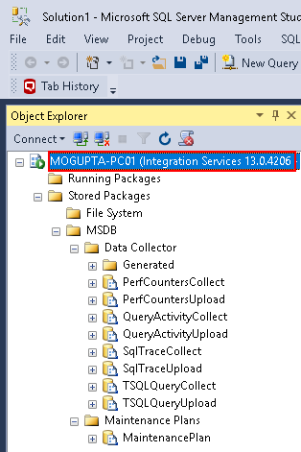
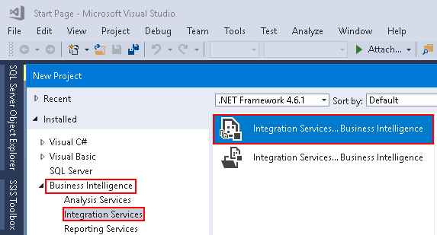
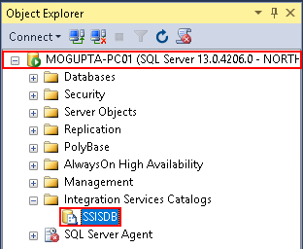
SSIS Components
Development & Management Tools
SQL Server Management Studio (SSMS)
SQL Server Data Tools (SSDT) Add-On for Visual Studio

Slide 6
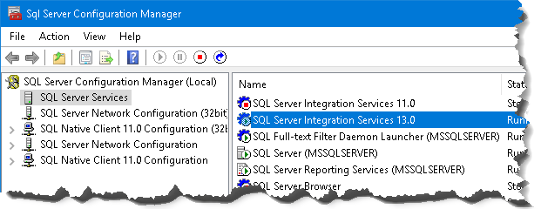
SSIS Components
SSIS Service
Extends the management capabilities of SSMS.
Generally installed on SQL Server instance.
Visible in SQL Server Configuration manager or SSMS.
Required for SQL Server SSIS DB Catalog.
Import/Export SSIS Packages.
Manually Execute/Stop SSIS Packges.
Provides ability to monitor executions.
Notes:
https://support.microsoft.com/en-us/help/942176/description-of-the-sql-server-integration-services-ssis-service-and-of

Slide 7
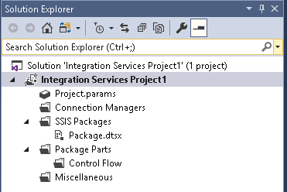
SSIS Components
Project & Packages
Projects allow the ability group packages and objects with similar workload together.
Projects can contain packages, connection manager (shared connections), parameters, etc.
Tip: If solution explorer is not visible, you can launch via View Menu > Solution Explore or keyboard shortcut CTRL + W, S

Slide 8
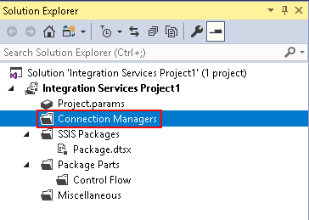
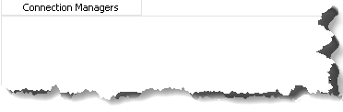
SSIS Components
Connection Managers
Provide ability to collect to data sources for both source and destination.
Ability to create connections both at project level and package level.

Slide 9
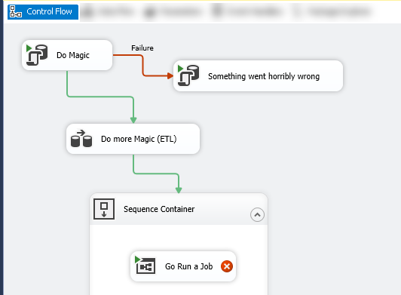
SSIS Components
Control Flow
Tasks
Constraints
Containers

Slide 10
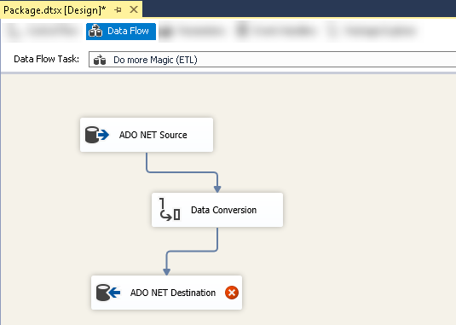
SSIS Components
Data Flow
Extract
Transform
Load

Slide 11
SSIS Components
SSIS CatalogDB
Objects stored here are projects, packages, parameters, environments, and operational history.
Notes:
https://docs.microsoft.com/en-us/sql/integration-services/catalog/ssis-catalog?view=sql-server-2017

Slide 12
SSIS Catalog DB
Demo

Slide 13
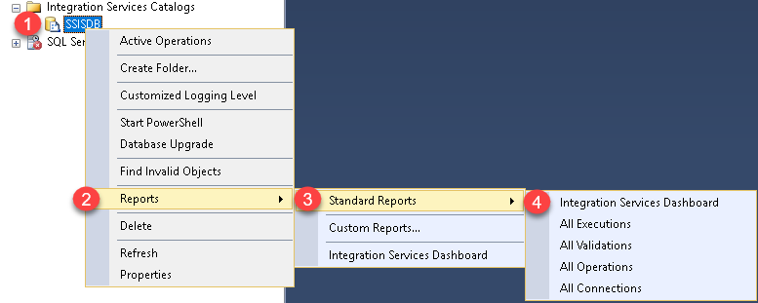
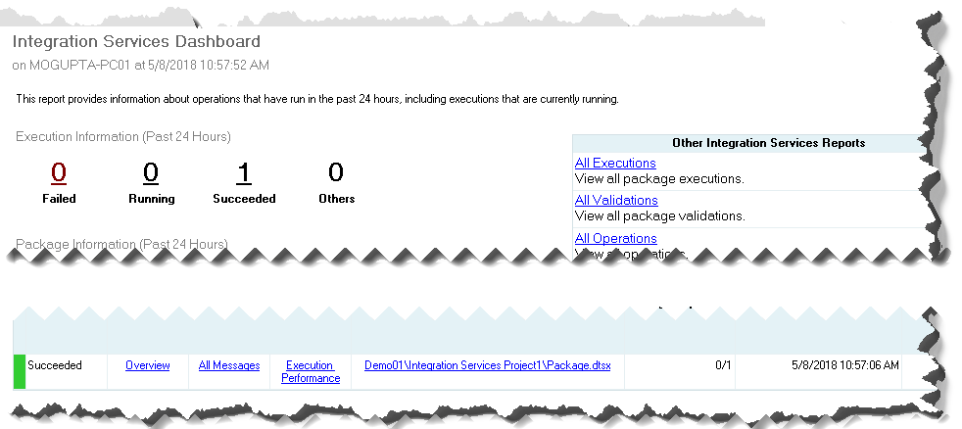
SSIS Components
SSIS Reports
Provide execution history of all the packages in SSIS Catalog DB.

Slide 14
New to SSIS 2016
Manageability
AlwaysOn Support for SSIS Catalog
Incremental Package Deployment
Support for Always Encrypted for SSIS Catalog
Debugging
New security roles.
New logging levels/server wide settings.
Better Package Management
Project Upgrade
Reusable Control Flow Templates
Connectivity
Expanded connector for Odata, Hadoop, SAP BW, Azure Cloud, etc.
Notes:
https://docs.microsoft.com/en-us/sql/integration-services/what-s-new-in-integration-services-in-sql-server-2016?view=sql-server-2017

Slide 15
SSIS Catalog DB
Lab

Slide 16
Questions?
What are some of the components of SSIS?
SSIS Catalog DB, Control Flow, Data Flow, etc.
Which phase of the ETL is usually the most expensive?
Transport is the most expensive phase, in most ETL processes.
Can we create multiple SSIS Catalog DB per instance?
No limited to one SSIS catalog database per instance.
What high availability option do we recommend for SSIS?
AlwaysOn Availability Groups

